Slide 1
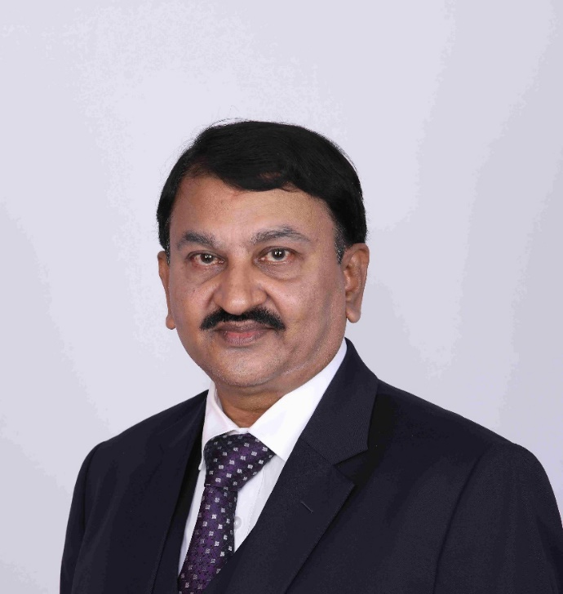
  Name: Dr. N.M. Suresh MBBS MS
  Education: M.B.B.S at Dr. B.R. Ambedkar Medical College 1987
          M.S (Anatomy) Bangalore Medical College 1998

Slide 2
  Teaching Experience in Anatomy
  Joined as Lecturer in Anatomy at Bangalore Institute of Dental Science, Bangalore in 1991
  Has worked in SDUMC- Kolar, SSMC- Tumkur & SIMS- KGF and TOMCH & RC.
  Working as Professor & HOD of Anatomy
  at Sri Chamundeshwari Medical College, Channapatna since 1st January 2023.
  Teaching experience of 32 years

Slide 3
  Academic Activities
  Published 25 articles in International, National & State Journals
  Presented 20 research papers in International, National & State Conferences
  Has been Resource person in “Medical Education Technologies” & “ECLS”
  Has organized 7 State CME’s.
  Has organized 2 “Anatomy Day” celebration

Slide 4
  Life Member of following Organizations
  Indian Medical Association
  Indian Association of General Practitioners
  Bangalore Medical College Alumni Association
  Karnataka Chapter of Anatomists
  Society of Clinical Anatomists
  Indian Epilepsy Association

Slide 5
Posts held by Dr. N.M. Suresh
    General Secretary of “Karnataka Chapter of Anatomists” since 2006 to 2015.
    Treasurer of “Karnataka Chapter of Anatomist” from 2016 to 2019.
    General Secretary of “Karnataka Chapter of Anatomists” since 2019 till date.
    General Secretary of “Bangalore Medical College Alumni Association” since 2016 till date.

Slide 6
Awards
“Best Secretory Award” at World Congress of Anatomists & 19th Karnataka Chapter of Anatomists conference 2017 held at Gadag Institute of Medical Sciences, Gadag. Karnataka. India.
“Arjuna Award” for excellence services rendered towards establishment of Karnataka Chapter of Anatomists at 20th State level conference of Karnataka Chapter of Anatomists held on 29th & 30th of September 2018 at Adichunchangiri Institute of Medical Sciences, Nagamangala.
Recipient of “Diamond Ring” from Dr. Mrs. S. Kantha at 21st State Conference of Karnataka chapter of Anatomists held on 12th September 2019 at Bangalore Medical College & research Center.
Prestigious “Dr. Henry Grey Award” in recognition of his exemplary Lifetime service in education & research on World Anatomy Day 15th October 2022.
Prestigious “Vaidya Ratna Award” in recognition as a distinguished Anatomist & passionate Teacher, a great administrator with commitment and patience and an inspiring leader with a vision at World Global Congress of Anatomists at Gadag on 9th December 2022, .

Slide 7
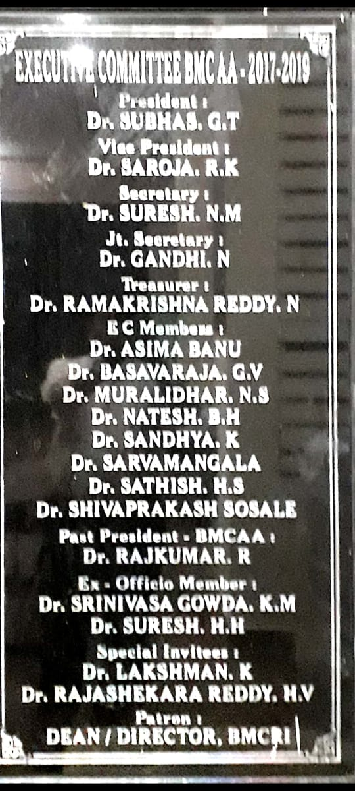
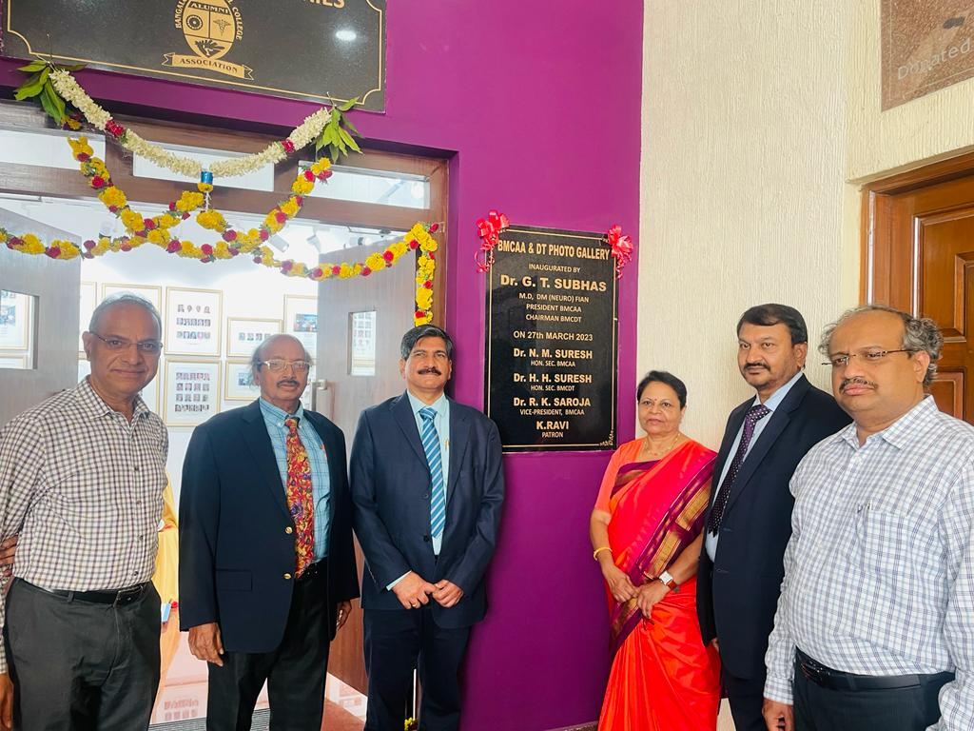
Bangalore Medical College Research Institute

Slide 8
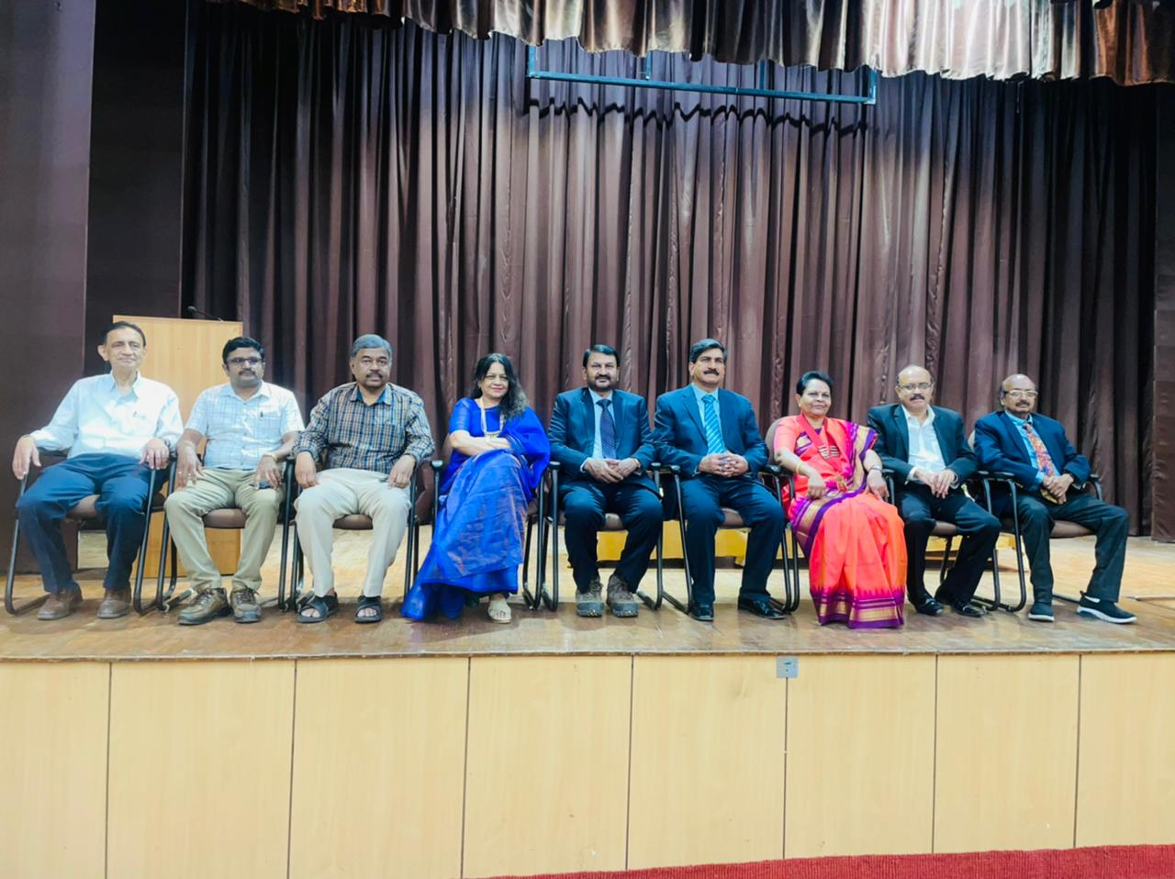
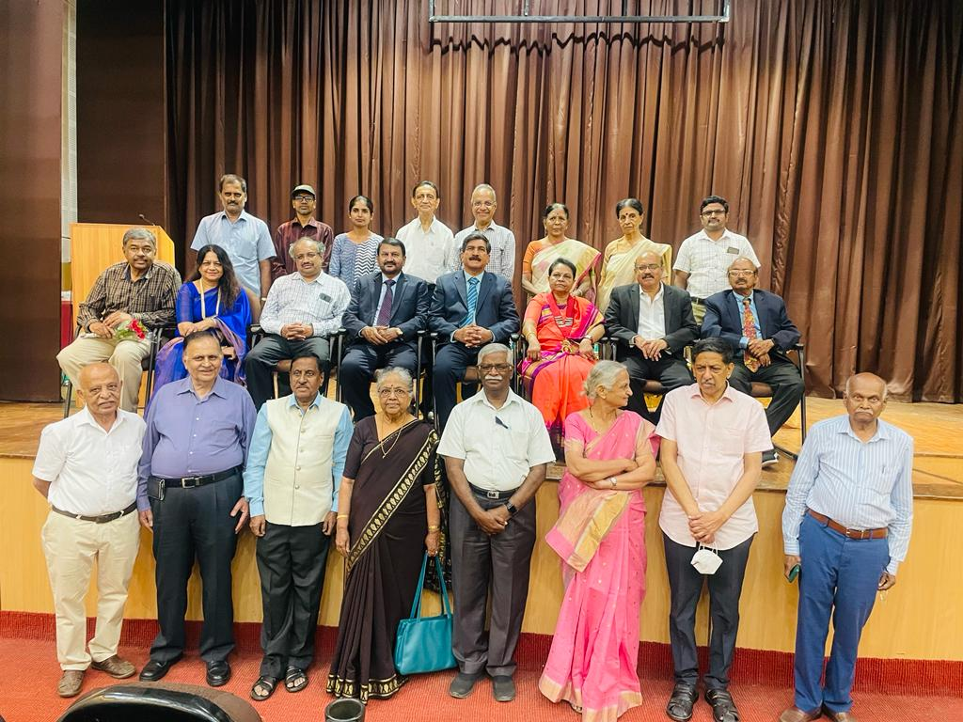
Bangalore Medical College Research Institute

Slide 9
  As a writer & Publisher:
    “THE ESSENCE OF BHAGAVADGITA FOR MEDITATION” published by “OM Publishers” in the year 2006.
    “TEACHINGS OF BUDDHA- For a Practical Day to Day Life” published by “OM Publishers” in the year 2008.

Slide 10
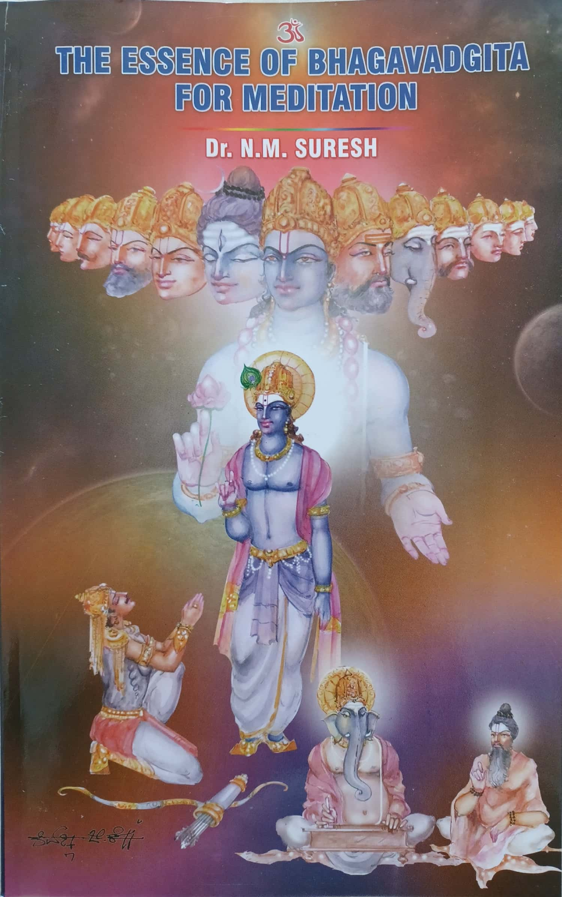
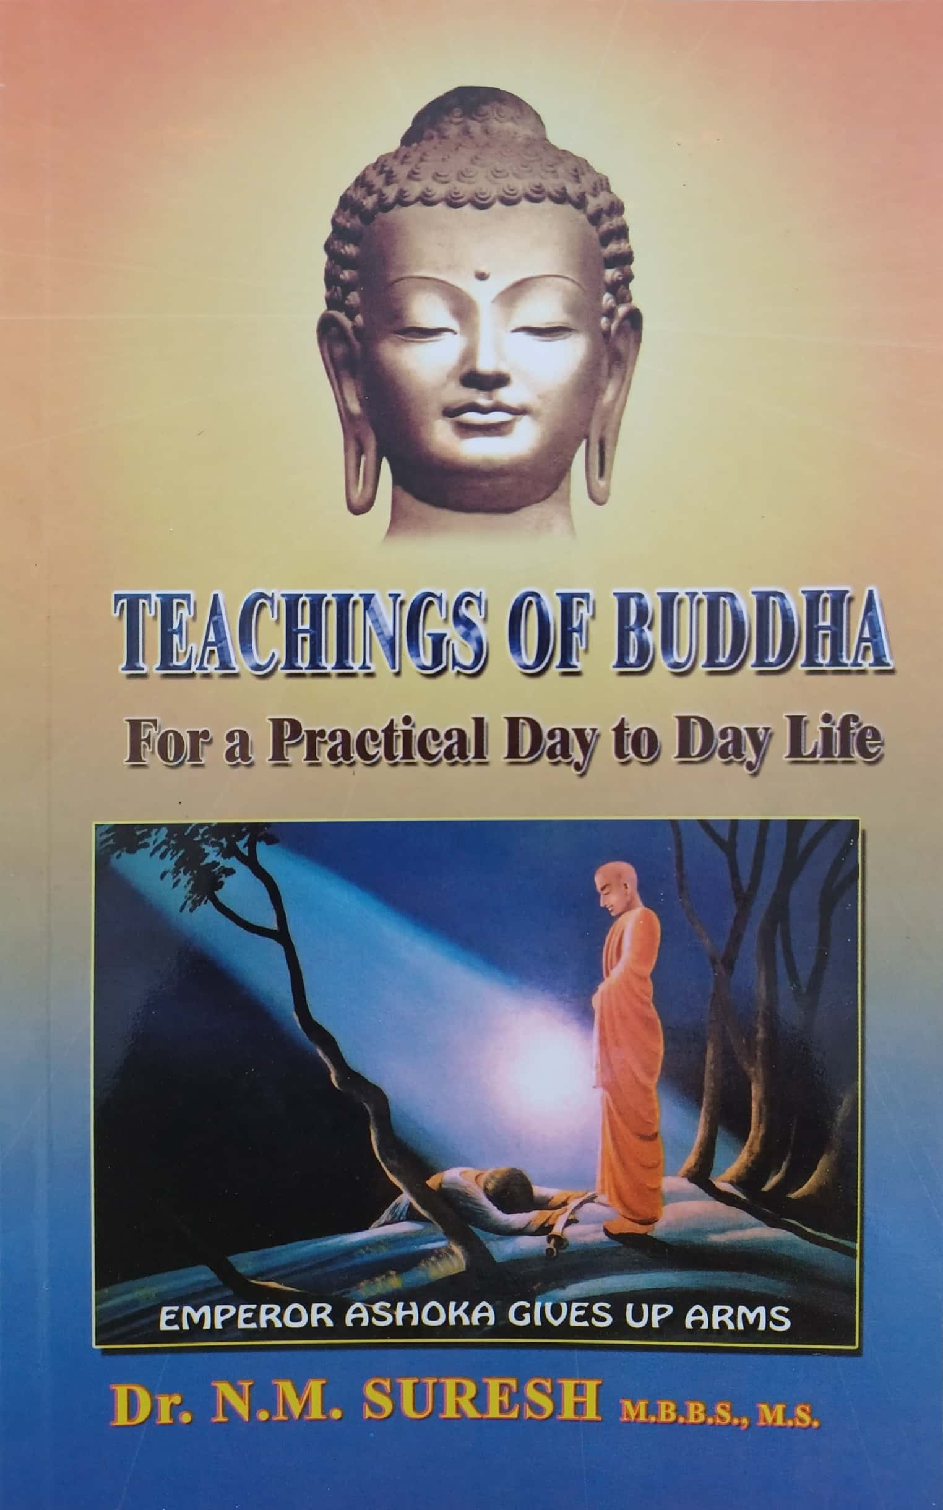
Books Published

Slide 11
  Annual awards Instituted by Dr. N.M. Suresh
    “Sushuratha Gold Medal Award” for Excellence in the field of Anatomy awarded Posthumously.
    “Sushuratha Gold Medal Award” for Excellence in the field of Anatomy awarded during Lifetime.

